Slide 1

B.Tech. Major Project Report
On
excel implementation of regression clustering
BY
ABHISHEK MAHESHWARI (11115004)
TORAN SAHU (11115086)
Under the Guidance of
Dr. N. K. NAGWANI
(Assistant Professor)
DEPARTMENT OF COMPUTER SC. & ENGINEERING
NATIONAL INSTITUTE OF TECHNOLOGY
RAIPUR - 492010, CHHATTISGARH, INDIA
MAY, 2015

Slide 2
Introduction
Objective and Scope
Four Major Stages
Data Preparation from Excel File
Clustering
Regression on Clustered data
Error Estimation
Performance Measurement
Execution Flow of the Project
Output
Conclusion

Slide 3
Objective and Scope
The main idea behind the project is to extract data from Excel Files and minimize the error while predicting the value of an attribute.
Scope:
Study various datasets to classify them in different sub datasets to make efficient prediction.
Comparison of different clustering algorithms.

Slide 4
Four stage process
Extracting data from Excel file
Data is extracted from Excel files to a specific format.
Clustering
The data is classified in sub datasets using data mining algorithm .
Regression
Regression methods are applied to get the relation between dependent variable with the independent variables.
Error Estimation
The same dataset is used to estimate the error between predicted vale and the original value.

Slide 5

Basic Process

Slide 6
Data Extraction from Excel file
Input File path
Extraction of File name from file path
Import to SQL Database
Conversion to .arff format

Slide 7
Clustering
Cluster Count Input
Clustering Algorithm Implementation
K-Means
Clustered Excel File Generation
Clustered Excel Files to .arff conversion
Count.txt file generation

Slide 8
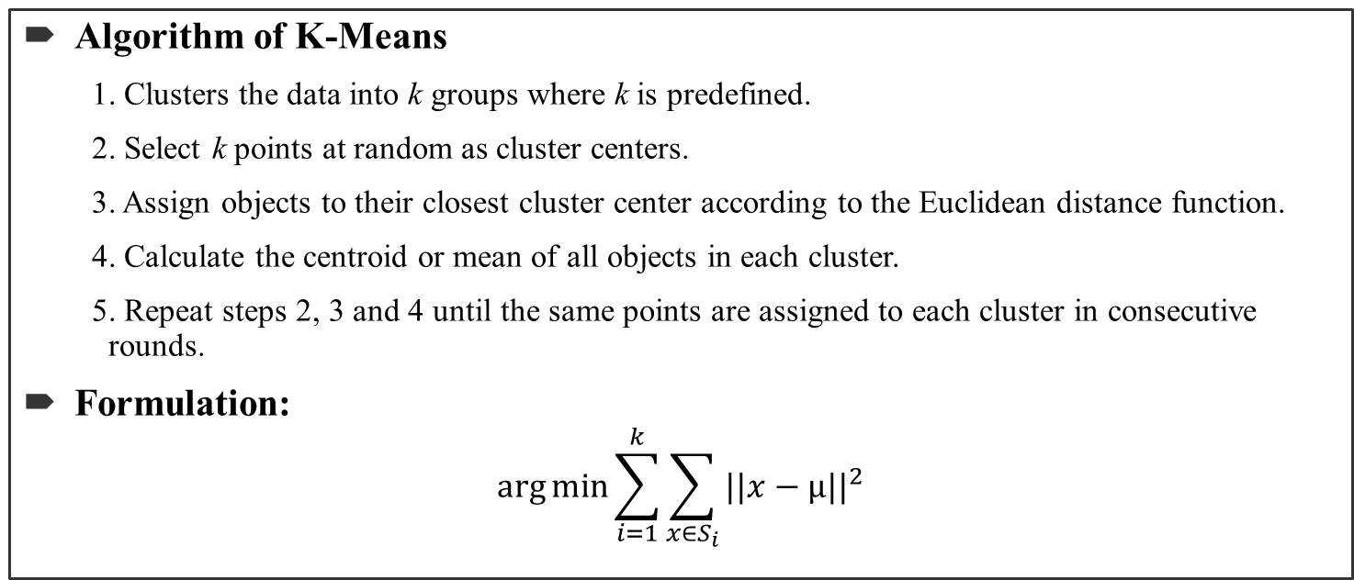
K- Means
Algorithm of K-Means
1. Clusters the data into k groups where k is predefined.
2. Select k points at random as cluster centers.
3. Assign objects to their closest cluster center according to the Euclidean distance function.
4. Calculate the centroid or mean of all objects in each cluster.
5. Repeat steps 2, 3 and 4 until the same points are assigned to each cluster in consecutive rounds.
Formulation:
$$\arg{\min{\sum_{i=1}^{k}{\sum_{x∈S_{i}}{{||x−µ||}^{2}}}}}$$

Slide 9
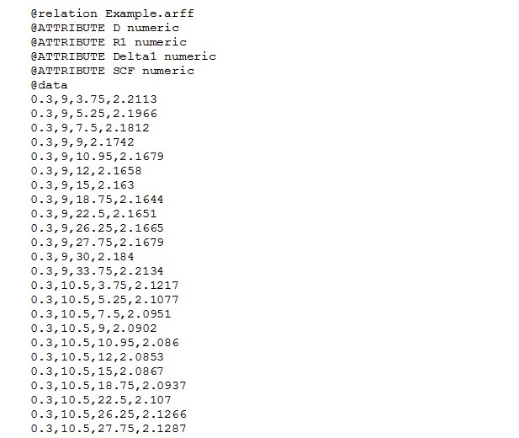
Attribute-Relation file format
Usage:
Weka API is used to implement regression methods so the input to these methods should be in .arff format.
Format:

Slide 10
Regression on Clustered Data
Two methods of Regression
Linear Regression
Least Median of Squares regression
Equation Generation
Dependent variable value prediction

Slide 11
Linear Regression
Given data {y_{i} , x_{i1} , . . . . , x_{ip} } from i =1 to n of n statistical units, a linear regression model assumes that the relationship between the dependent variable y_{i} and the p-vector of regression x_{i} is linear.
y_{i} = β₁x_{i1}+. . . . . . . . . . . . . . . . . . .+β_{ip}x_{ip} + ε_{i} = x_{i}^{T} β + ε_{i} , i = 1,. . . . . . , n.
i.e. Y = Xβ + ε

Slide 12
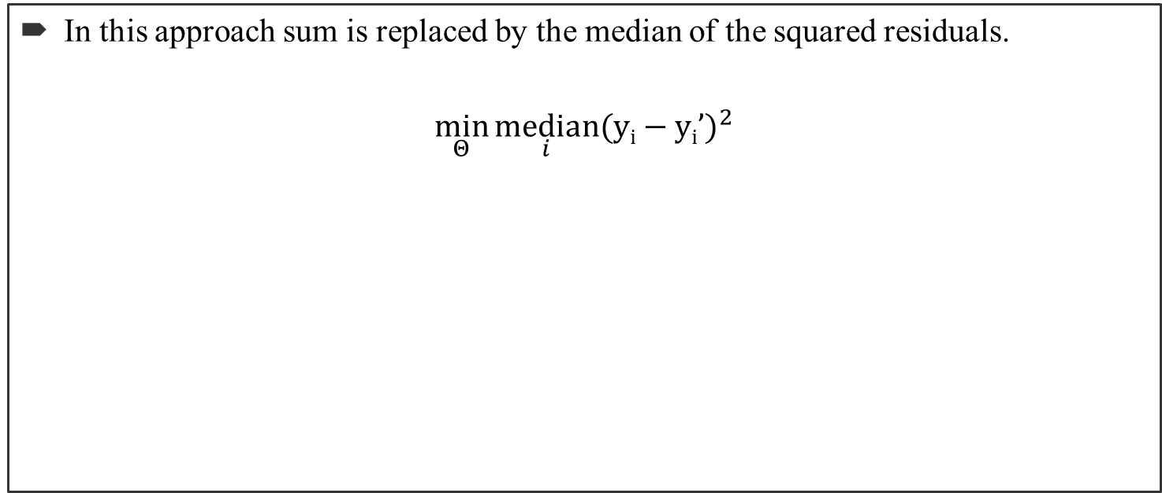
Least Median Of Squares Regression
In this approach sum is replaced by the median of the squared residuals.
$$\min_{Θ}{\underset{i}{median}{{(yi−yi’)}^{2}}}$$

Slide 13
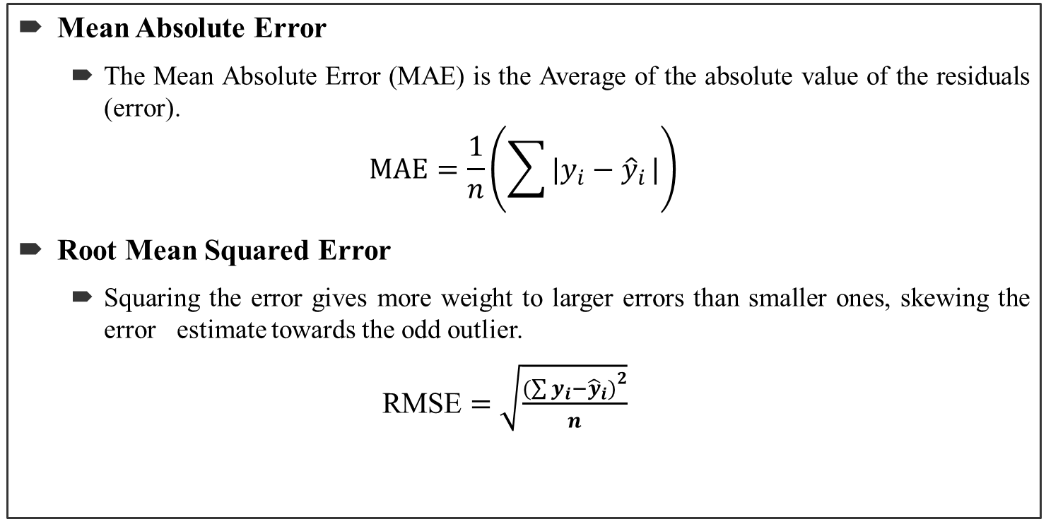
Error Estimation
Mean Absolute Error
The Mean Absolute Error (MAE) is the Average of the absolute value of the residuals (error).
$$MAE=\frac{1}{n}\left(\sum{|y_{i}−{\hat{y}}_{i}}|\right)$$
Root Mean Squared Error
Squaring the error gives more weight to larger errors than smaller ones, skewing the error estimate towards the odd outlier.
RMSE $=\sqrt{\frac{{(\sum{y_{i}−{\hat{y}}_{i})}}^{2}}{n}}$

Slide 14
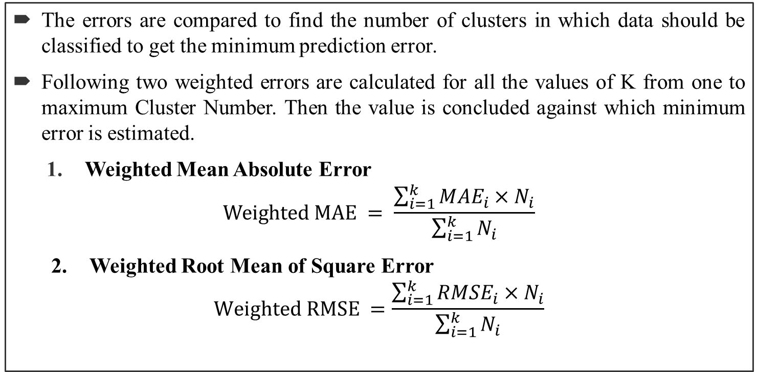
Performance Measurement
The errors are compared to find the number of clusters in which data should be classified to get the minimum prediction error.
Following two weighted errors are calculated for all the values of K from one to maximum Cluster Number. Then the value is concluded against which minimum error is estimated.
Weighted Mean Absolute Error
$$Weighted MAE = \frac{\sum_{i=1}^{k}{{MAE}_{i}×N_{i}}}{\sum_{i=1}^{k}{N_{i}}}$$
2. Weighted Root Mean of Square Error
$$Weighted RMSE =\frac{\sum_{i=1}^{k}{{RMSE}_{i}×N_{i}}}{\sum_{i=1}^{k}{N_{i}}}$$

Slide 15
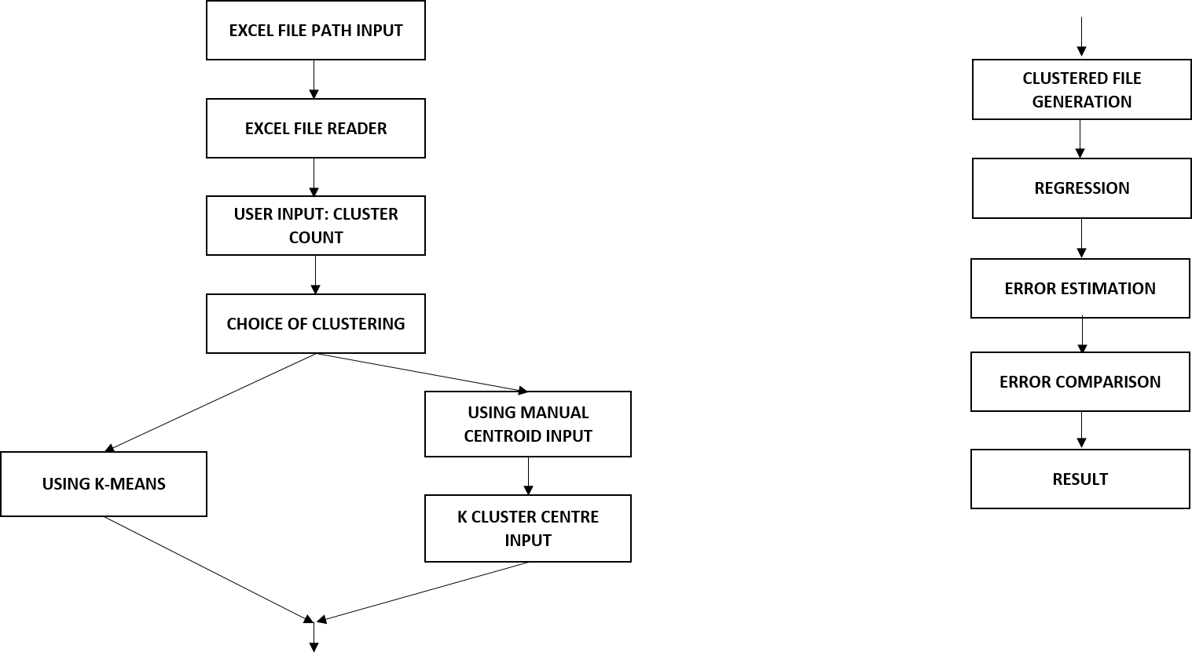
Execution Flow of the Project

Slide 16
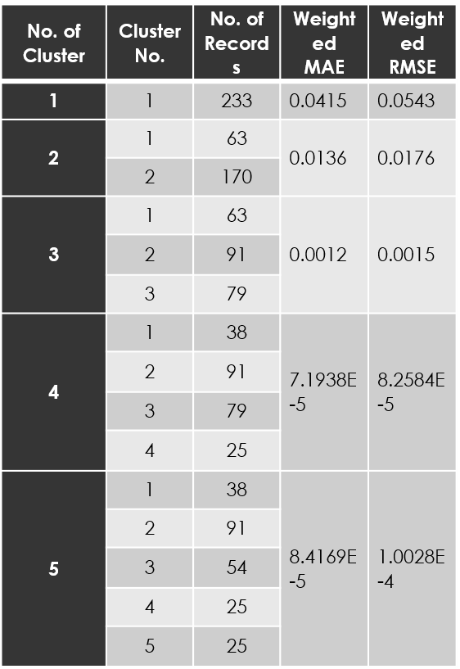
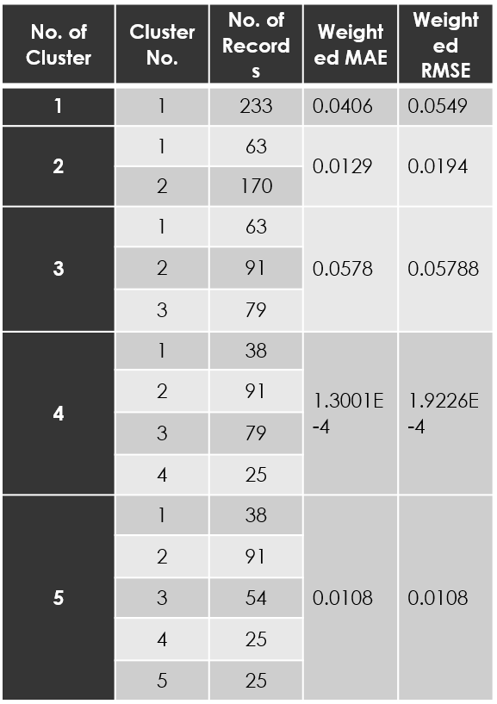
Output
Table. 1: MAE and RMSE using Linear Regression for different no. of clusters
Table.2: MAE and RMSE using LMS Regression for different no. of clusters

Slide 17
Conclusion
From Linear Regression we conclude that MAE and RMSE values are minimum for K=4.
From Least Median of Squares Regression we conclude that MAE and RMSE values are minimum for K=4.
It concludes that the given dataset should be clustered into 4 sub datasets to get minimum prediction error.

Slide 18
Thank You…

